Slide 1


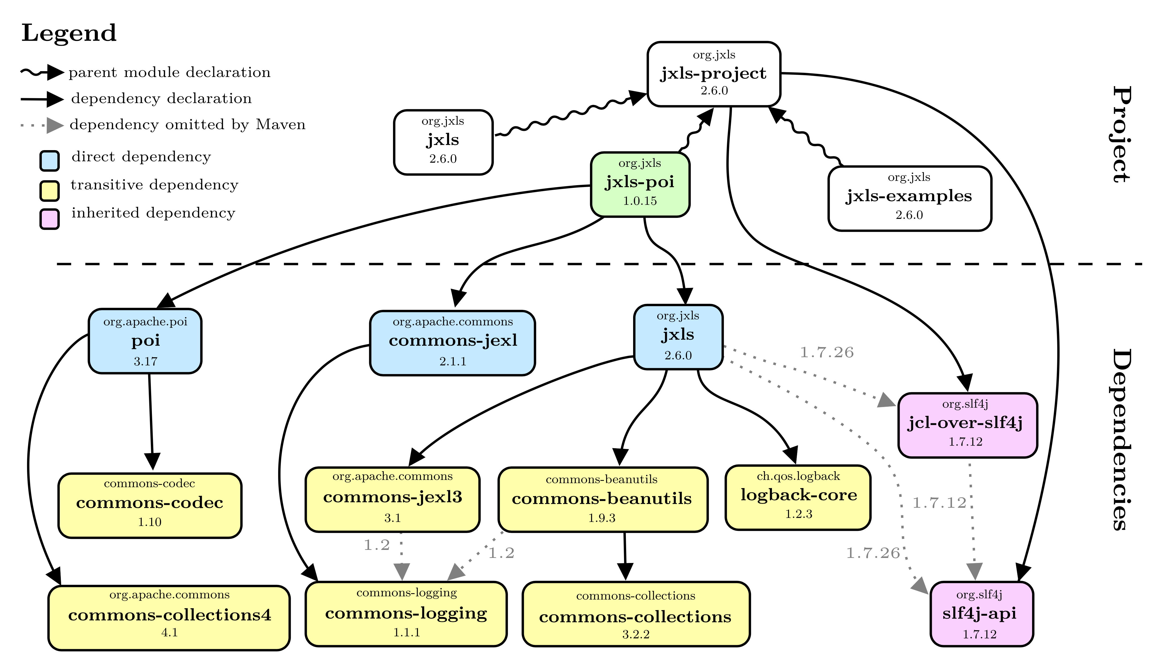
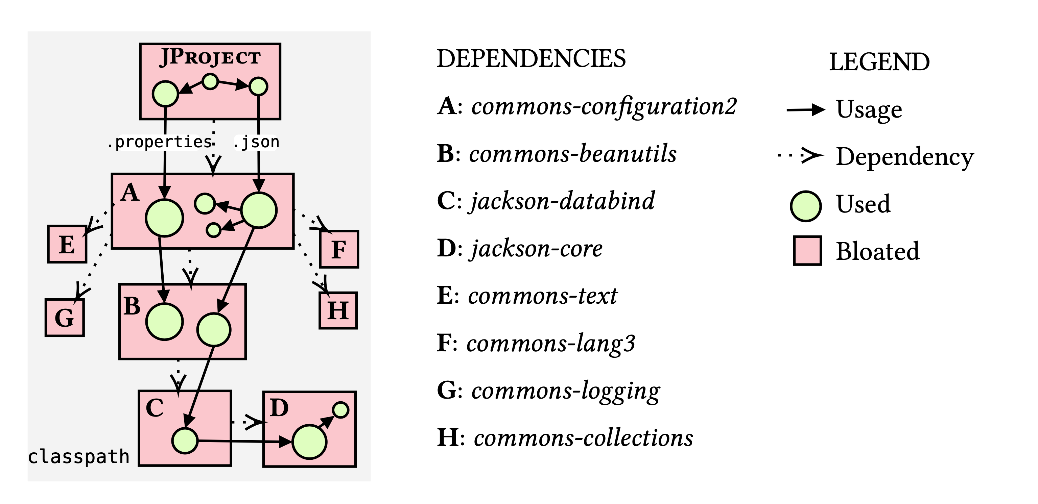
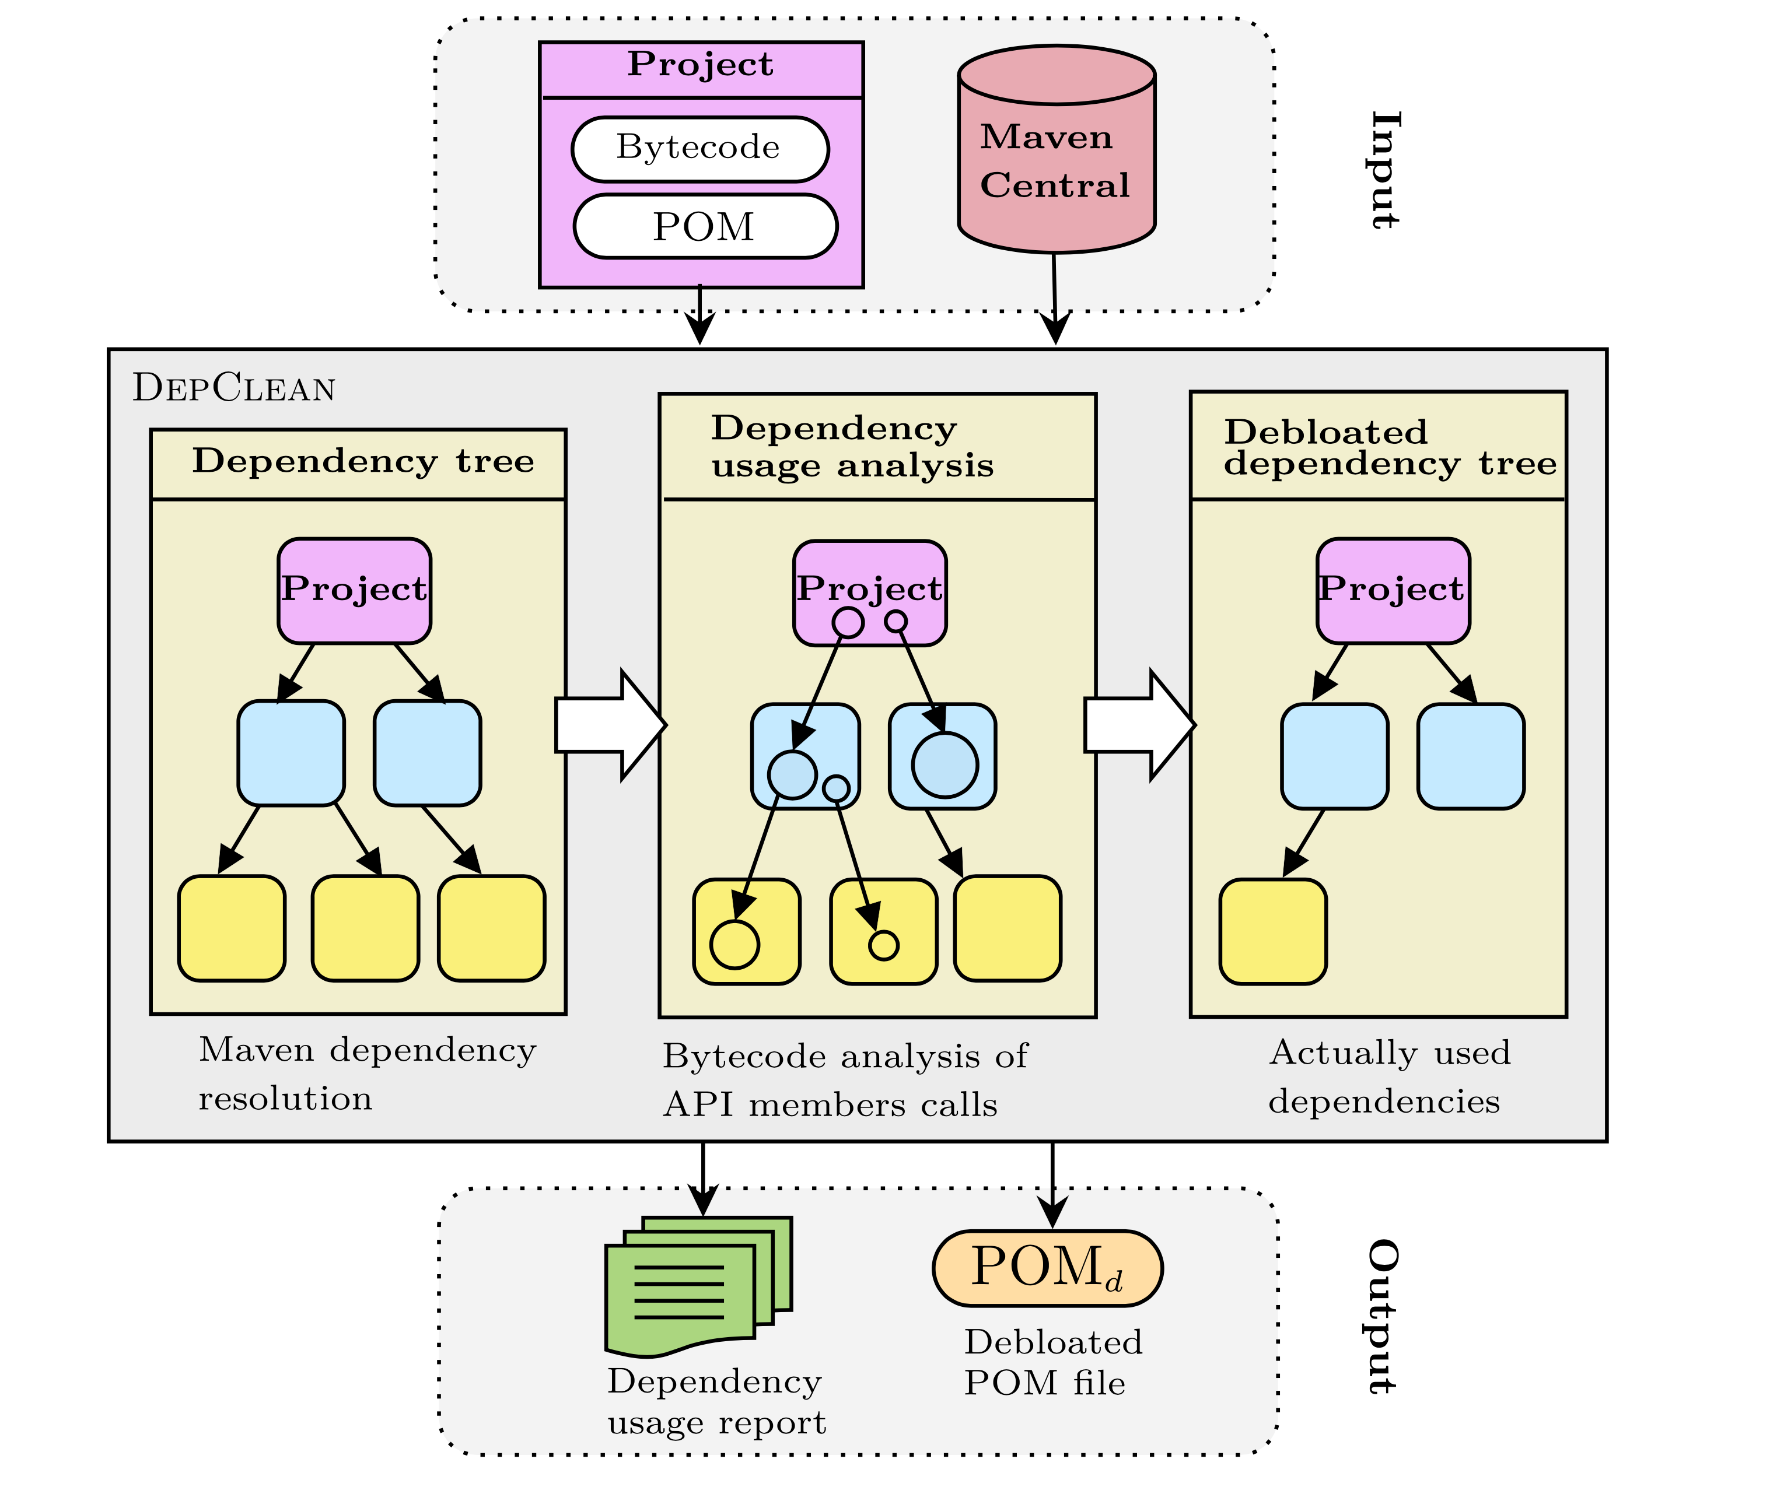
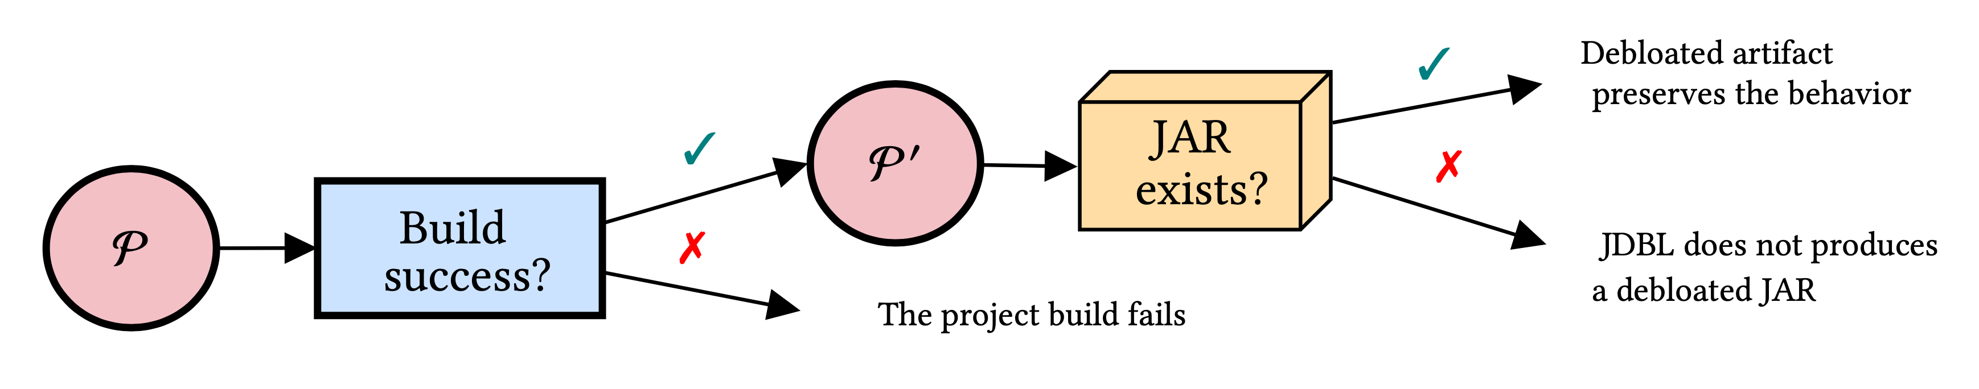
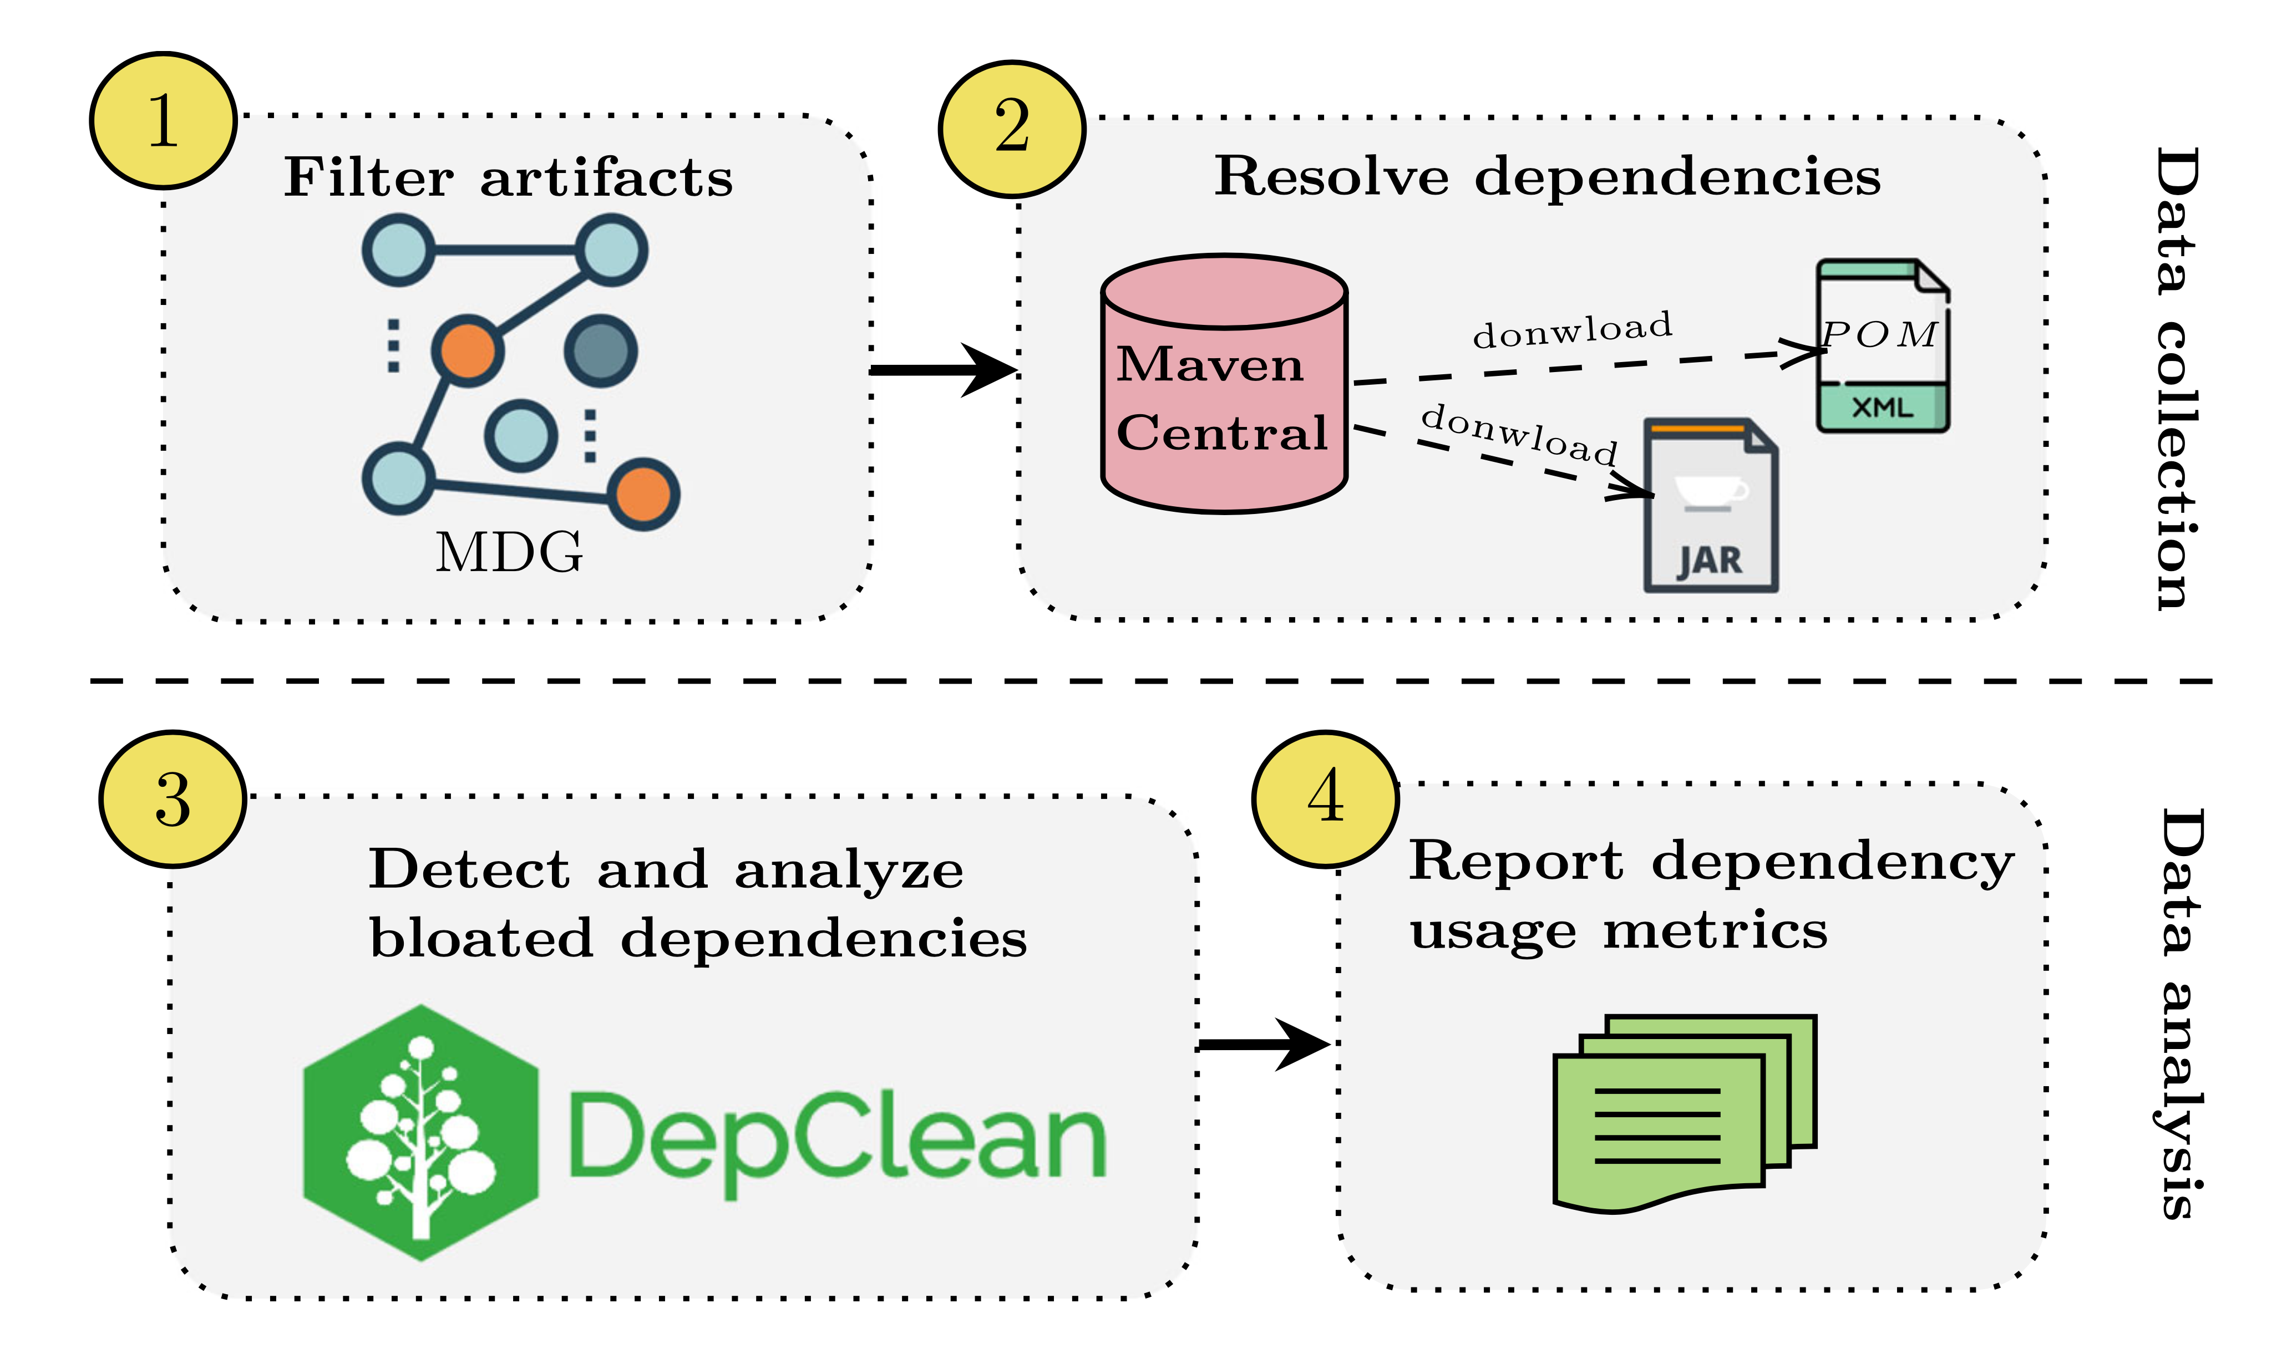
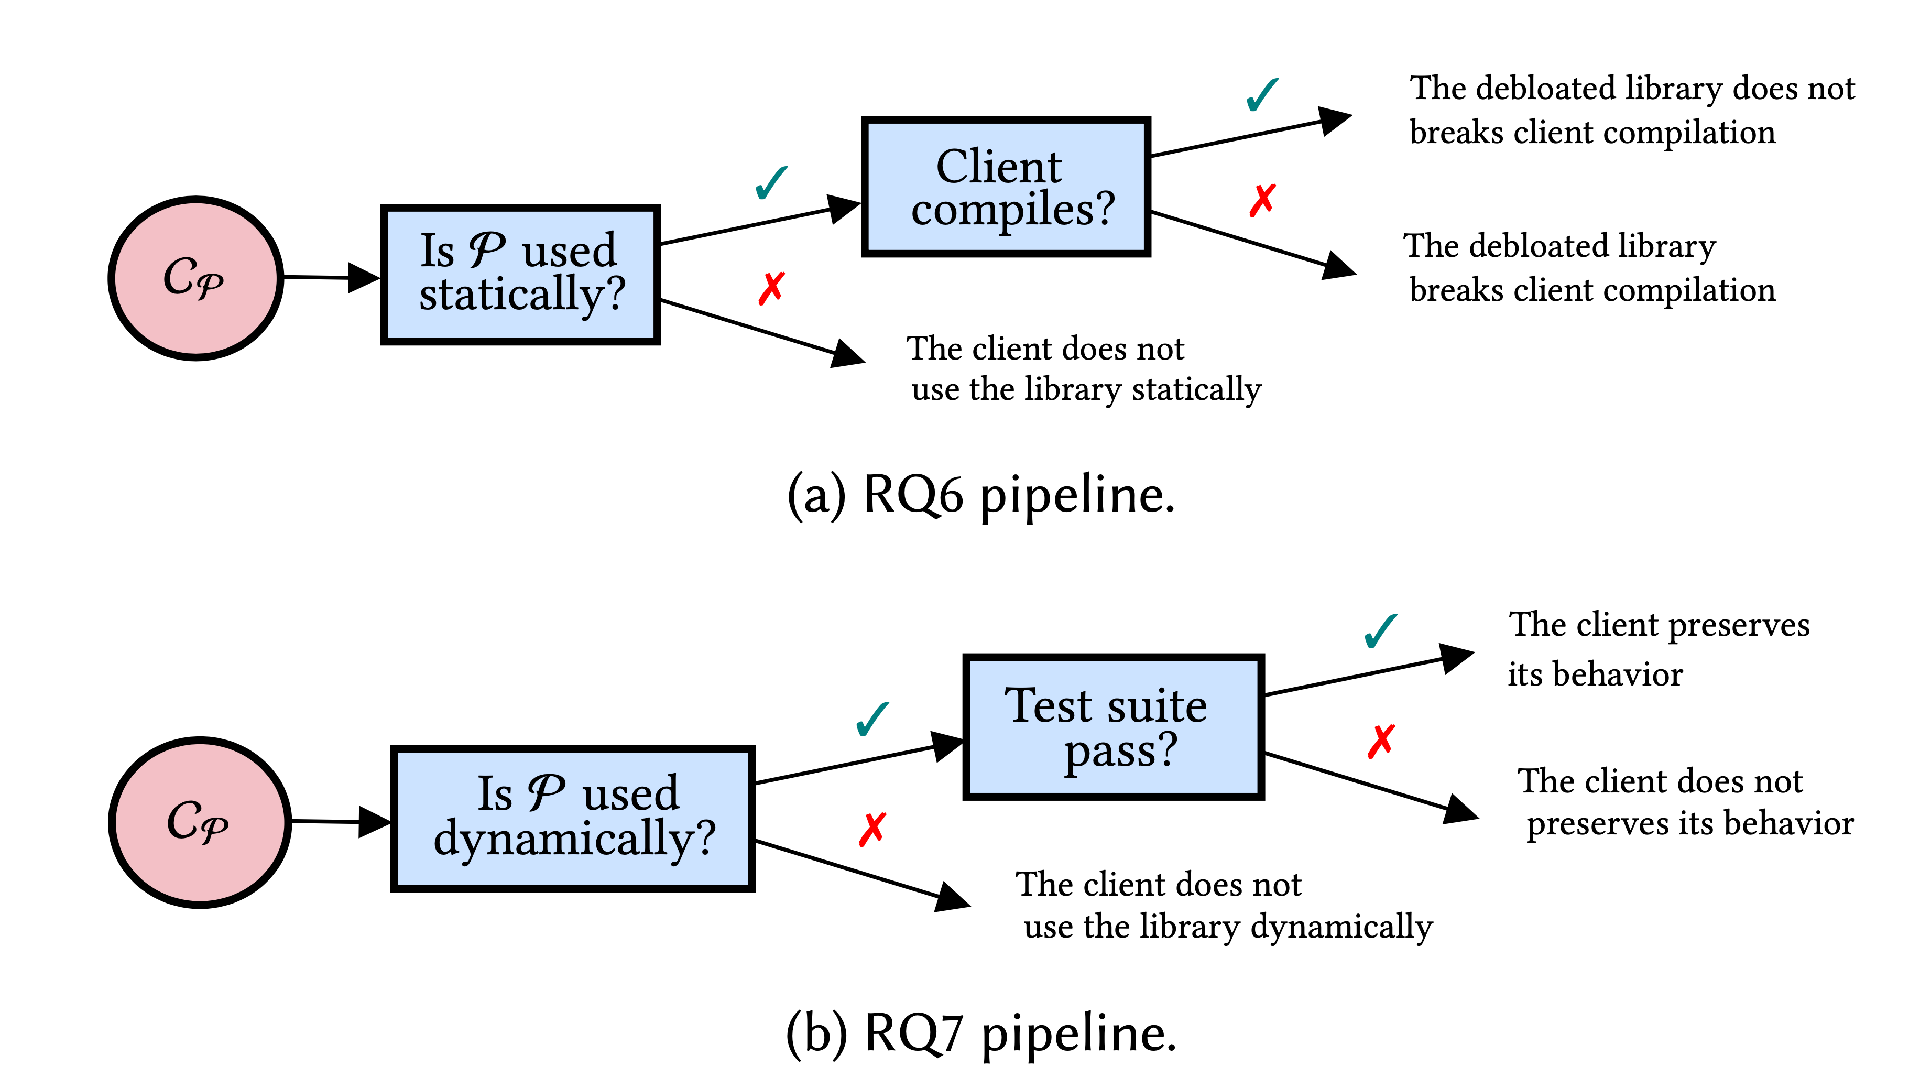
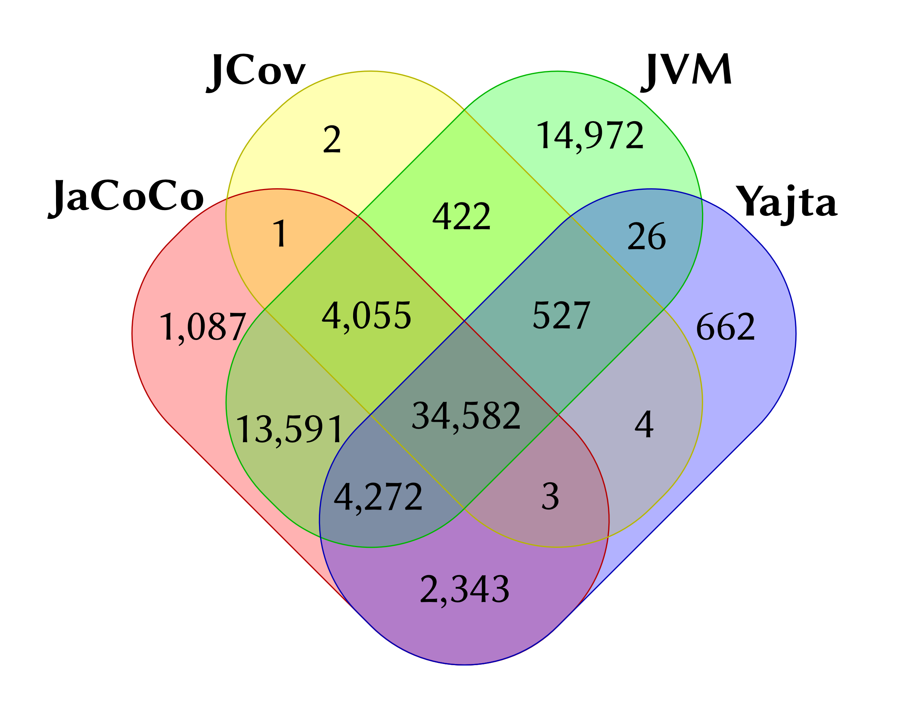
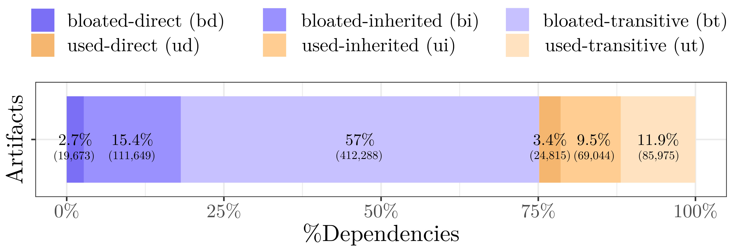
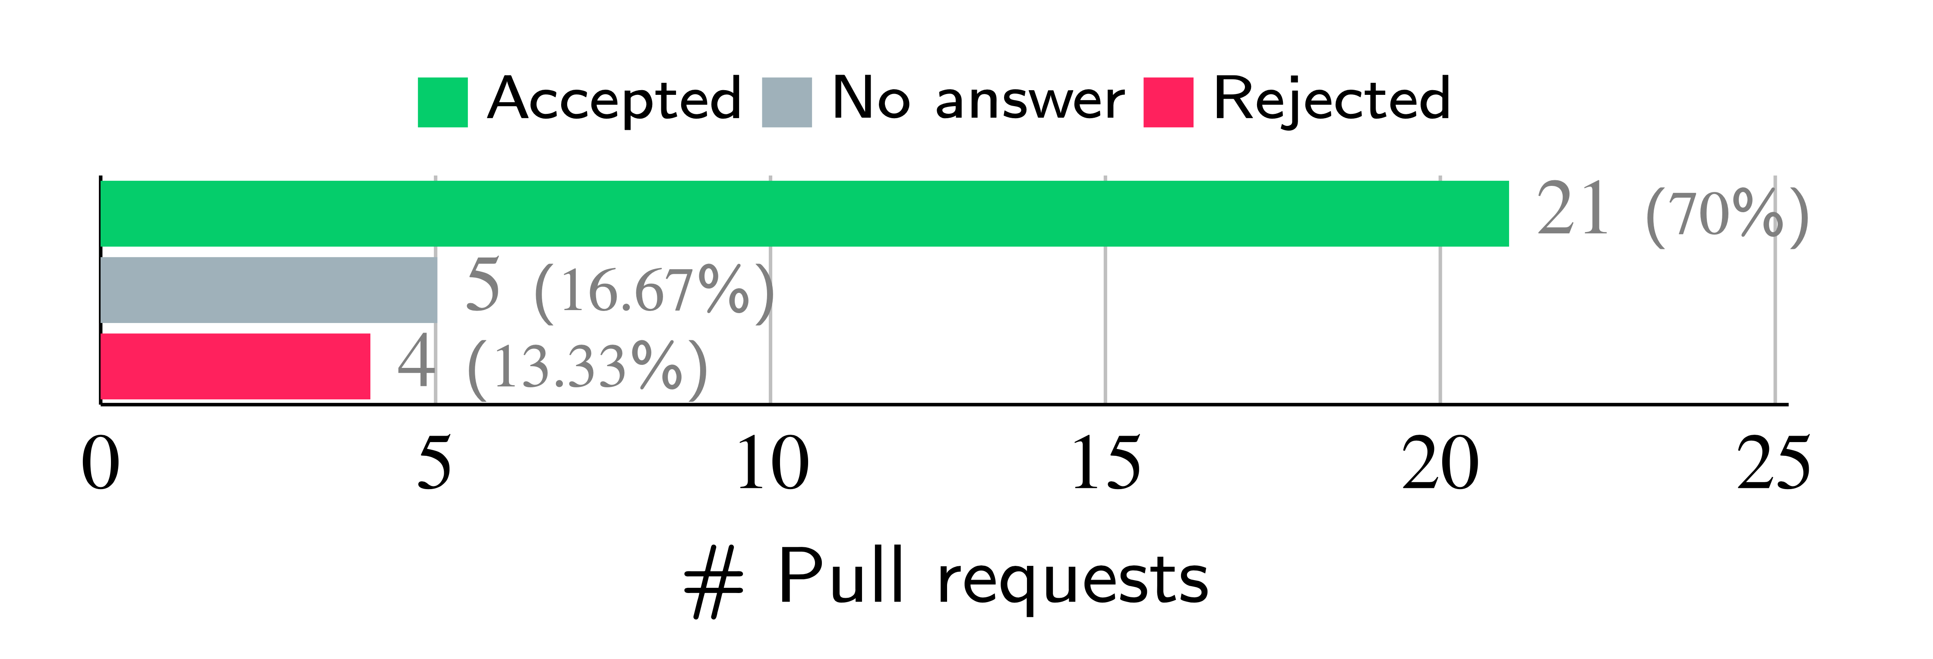
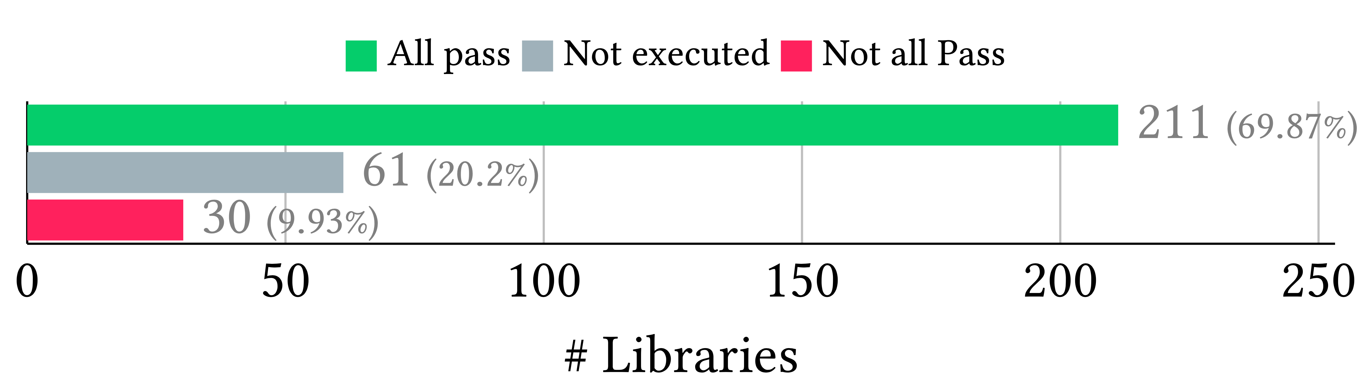
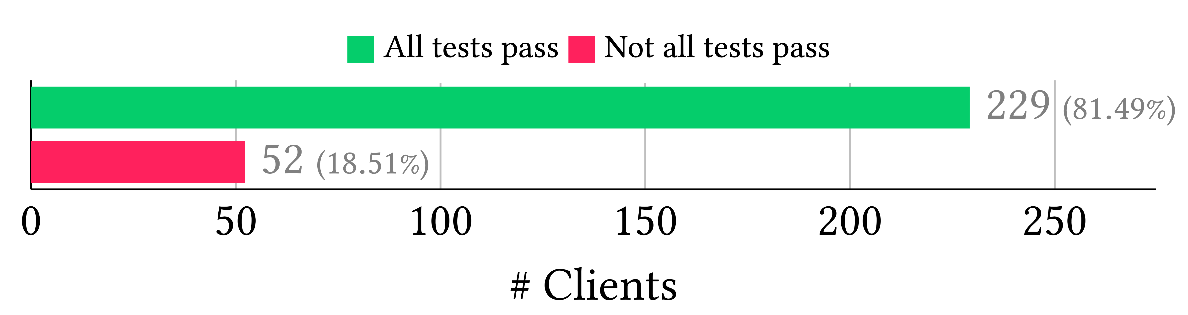
OPTIONAL LOGO HERE
Automatic Software Debloating
César Soto-Valero [cesarsv@kth.se]
Proudly supervised by Thomas Durieux, Martin Monperrus, and Benoit Baudry
Thankfully funded by WASP
Debloating Java Dependencies (Statically)
Debloating Java Bytecode (Dynamically)
“Developers declare software dependencies that they actually do not use in their projects.”
“The existence of disjoint execution paths makes Java projects susceptible to include unnecessary functionalities.”
Methodology & Tool
Methodology & Tool
https://github.com/castor-software/depclean
https://github.com/castor-software/jdbl
DepClean automatically detects and removes bloated dependencies in Java projects through static analysis.
JDBL automatically removes unnecessary bytecode from Java projects using coverage tools and dynamic analysis.
Results
Results
75% of the dependencies in the Maven Central repository are bloated dependencies.
21/26 of answered pull requests have been merged, removing 140 bloated dependencies in total.
68.3% of the libraries’ bytecode and 20.3 % of their total dependencies can be automatically debloated.
81.5% of the clients preserve their behavior when the original library is replaced by its debloated version.
📌 A Comprehensive Study of Bloated Dependencies in the Maven Ecosystem. Springer Empirical Software Engineering.
📌 Coverage-Based Debloating for Java Bytecode. ACM Transactions on Software Engineering and Methodology.

